Slide 2
Assessing DofE sections
How to best support DofE participants as sectional assessors
- DofE programmes overview
- The role of the Assessor
- Key interactions throughout the programme
- Resources
- Useful tips and best practice

Slide 3
What is the DofE?
A life-changing adventure for young people aged 14-24
It helps young people develop skills for their future life and work
It gives young people the chance to make new friends, follow their passions, learn new skills and make a difference in their community.
Notes:
It gives young people the chance to make new friends, follow their passions, learn new skills and make a difference in their community.
Gaining a DofE Award is a great way to impress future employers too. ​
It’s also non-competitive and a powerful way for every young person to build belief in themselves, whatever their background, interests and abilities. ​
​

Slide 4
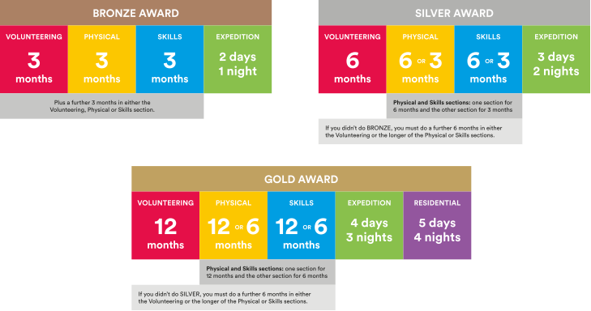
What is involved?
Participant is expected to commit to the activity on a regular basis
→ 1 hour per week
→ must cover the timescale at a minimum
Notes:
There are three levels of DofE Award – Bronze, Silver and Gold. To achieve the Award, participants will need to complete four sections – Volunteering, Physical, Skills and Expedition (add residential for Gold). ​
​The length of time they will need to devote to each section will vary, depending on whether they are at Bronze, Silver or Gold level.​
Choosing which activities to do for each section may seem daunting for your young people. But it’s important to remember that most activities can count.
Many young people will already take part in activities which can be counted towards their DofE Award, and there are a huge number of activities on offer for young people who are keen to try something new.​
Assessors are people who check that activities have been completed and describe the progress that has been made. An assessor should be somebody who has a good understanding of the chosen activity. It can be anyone apart from members of family or friends.
​I will now describe each section of the award in more detail.​
​

Slide 5
Volunteering section
Helping others and making a difference to the causes they care about
To inspire young people to make a meaningful contribution within their communities, influence change, and shape the world they want to live in.
Notes:
Every young person who pursues a DofE award will be asked to devote some time to volunteering.​
Through volunteering, young people have the opportunity to give up their time to help others or to make a difference to causes they feel passionate about.​
As well as changing things for the better, volunteering can be incredibly rewarding for young people – growing their confidence and sense of independence and gaining new skills they can use in their future lives and careers.​
​Examples of volunteering could be coaching a local football team, collecting items for a foodbank or campaigning for change on issues they feel passionate about.
Presenter: Feel free to use examples of previous participants here.
​The amount of time young people will need to volunteer for will vary depending on whether they are pursuing a Bronze, Silver or Gold Award. ​
​Young people can choose to volunteer in any area they would like – the only rule is that young people must not be replacing paid labour, for example by volunteering for commercial organisations.​

Slide 6
Physical section
Improving health and fitness and having fun along the way!
Notes:
A key component of any DofE Award is the Physical section, through which young people are encouraged to take part in regular physical activity. ​
​We know that regular physical activity improves young people’s physical and mental health so is a great habit to acquire when still young.​
​Almost any dance, sport or fitness activity can count – it’s completely up to them which activities they choose, including whether they seek to join a team or choose to do an activity on their own.​
​Completing the Physical section might be the push needed for a young person to try something completely different, or to concentrate and improve on something they are already doing. ​
​

Slide 7
Skills section
Developing existing skills or discovering new things to love
Notes:
Through the skills section, young people are encouraged to develop a set of practical and social skills.​
​They will be able to choose whether to develop their skills in areas where they have an existing passion, or to learn about something new.​
In the past, young people have used their skills section to develop their interests and talents in a huge range of areas including computer coding, driving and cooking
Qualifications outside of core education, project based work
​Through gaining interests and talents, young people will enjoy themselves and feel a real sense of achievement.​
​They’ll grow their confidence and show they’re committed, motivated and can rise to a challenge.​
​
​

Slide 8
What is an Assessor?
Assessors are people who check that activities have been completed and describe the progress that has been made.
An assessor should be somebody who has a good understanding of the chosen activity.
Either because
they oversee the activity and will have the best knowledge
OR
the participant has asked if you would be willing to regularly catch up to discuss progress.
It can be anyone apart from members of family or friends.

Slide 9
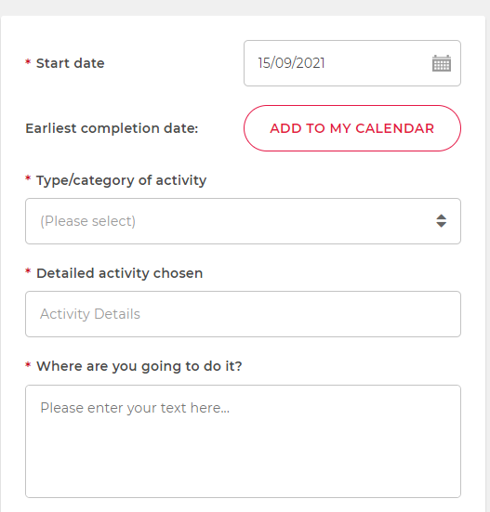
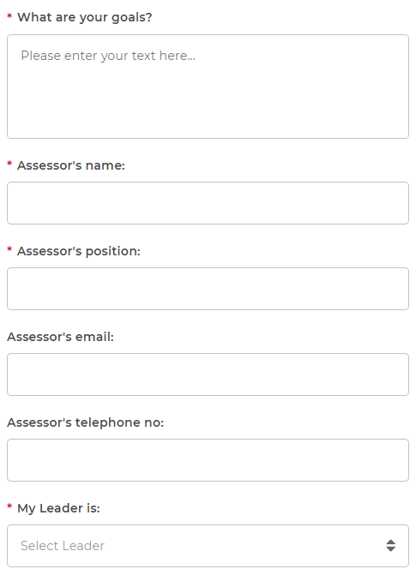
Before Activity…
Participants need to update their programme planners to reflect activity choice, goals, location and Assessor.
- Participant should ask you directly if you would be happy to assess, providing detail on their activity, goal and timeframe selected
- To consider : will the activity cover the minimum timeframe selected?
- Parents/carers are responsible for ensuring PP safety when attending external activities
If happy to – name will be provided on Programme planner, where DofE manager will review and approve.

Slide 10
During activity…
Once the participant’s programme planner has been approved by the DofE Manager, they can get started.
You may have varying involvement with your PP at this point
Delivering the activity on a 1:1 basis
Leading a group session held every week
Leading in the environment, so will develop an understanding of their abilities and progress over the timeframe
Supporting someone from afar, where their activity is independent. Would still be expected to have regular check ins to gain an understanding of progress to goal
- PP will keep track of time spent and will be in regular contact to update on progress
- May also ask you to sign off log books

Slide 11
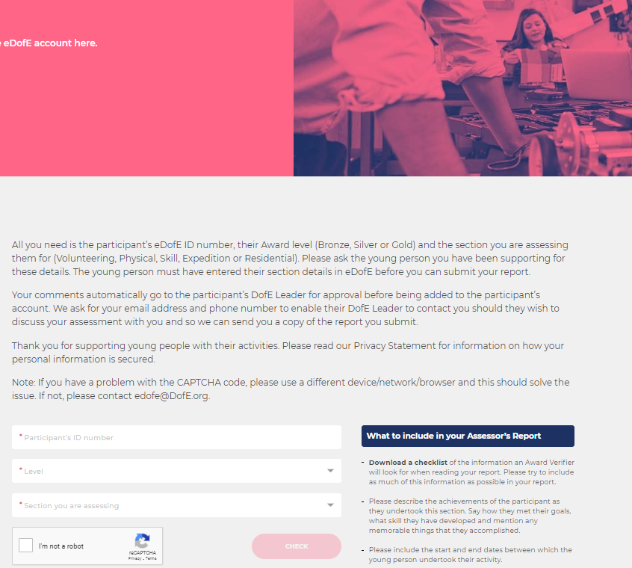
After activity…
Once the participant has fulfilled their timescale, they should ask you to complete the report to sign off the section
Reports can be completed by the following :
Assessor portal >
Handwritten report card > pp in charge of uploading
Other > emails/letters etc.
Basic report requirements:
- Start and end date/timeframe confirming time spent
- Confirmation of regular attendance
- Comment on Progress
- Assessor name and contact info
Assessors can submit reports using an online portal.
www.dofe.org/assessor
They will need to know:
Your eDofE Number
The level you are doing
Which section they are assessing
This will go directly to eDofE

Slide 12
Resources
Assessor portal link – www.assessor.org/Assessor
Assessor report card template
Activity log book

Slide 13
Insurance
The DofE doesn’t provide insurance through registration, this will be covered by the Licenced Organisation the participant signed up with
When an activity is selected externally to the LO, it is the responsibility of Parent/Carer to check suitability of the activity for their YP
Each organisation should make sure they have the necessary insurance in place to support volunteers – to be decided by your own internal systems, level of insurance in place etc.

