Slide 1
SGS Student Voice | Young Commissioners
Sutton Safety Survey
18 July 2024

Slide 2
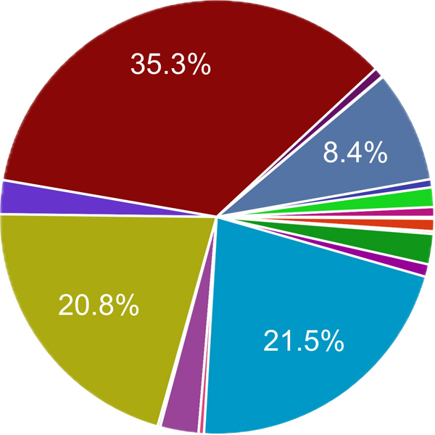
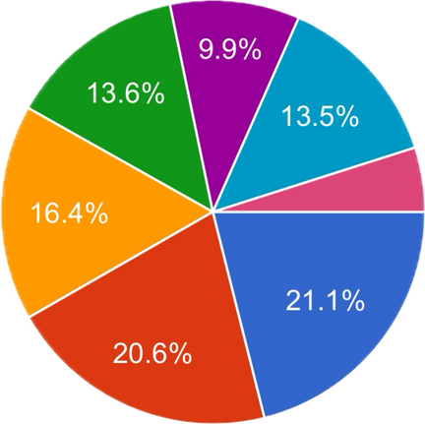
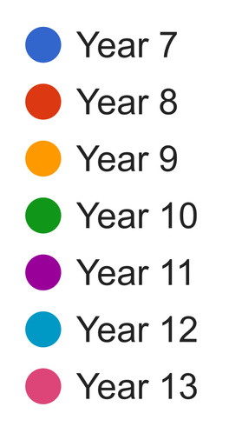
Key Data :
  Over 15 different schools participated within the survey.
  Highest number of participants within the survey were from Sutton Grammar School, Overton Grange, Glenthorne High School and Wallington County Grammar School
  These four schools alone made up 1,297 of the total 1,508 responses
  Participation by year group was even with the largest number of responses coming from KS3 students.
  A noticeable drop off for year 11 and 13s
Sutton Safety Survey

Slide 3
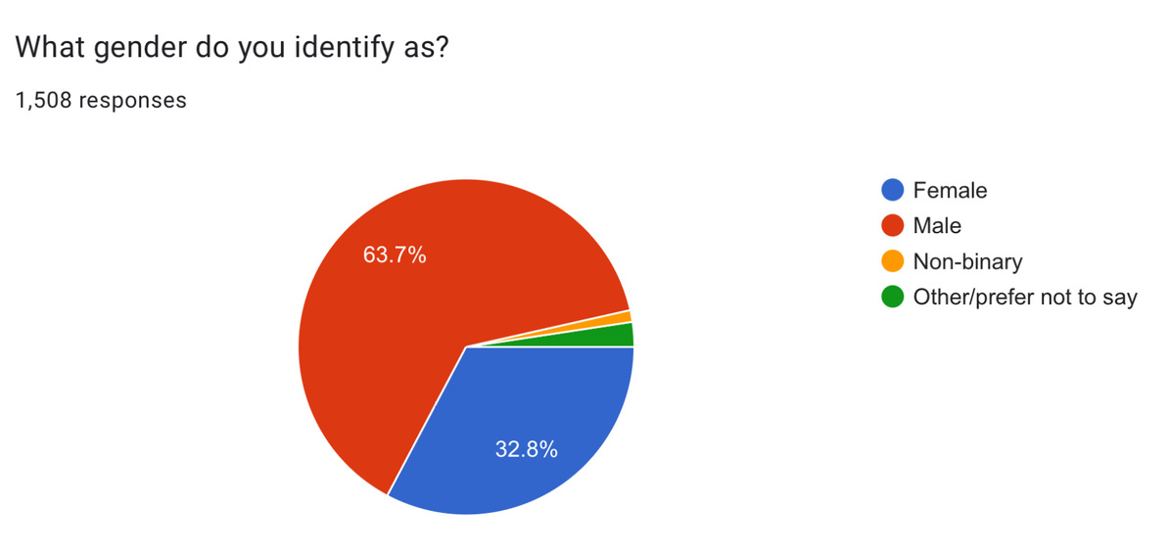
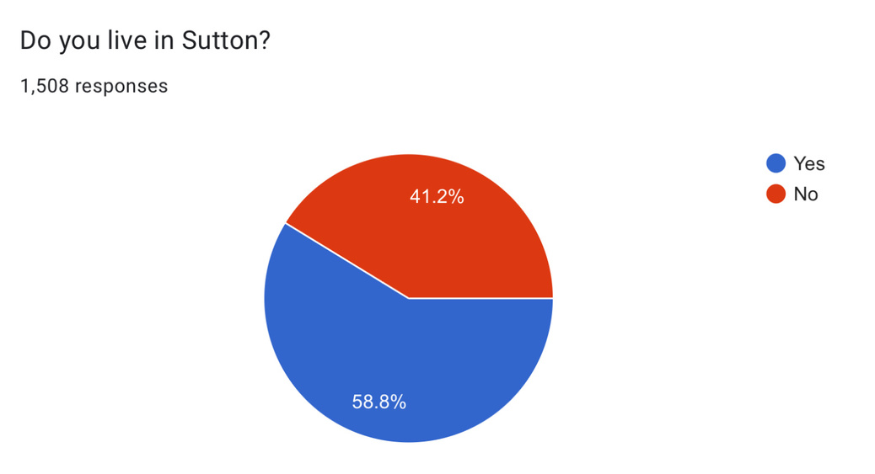
Key Data :
  Disproportionate male input into the survey with 961 males completing the survey compared to 494 females
  Key aim is to ensure we reach more girls schools better to allow for a more representative sample
  Survey also gave an insight into perceptions of safety from those living outside of Sutton (as seen form 622 (41.2% ) living outside the borough
Sutton Safety Survey

Slide 4
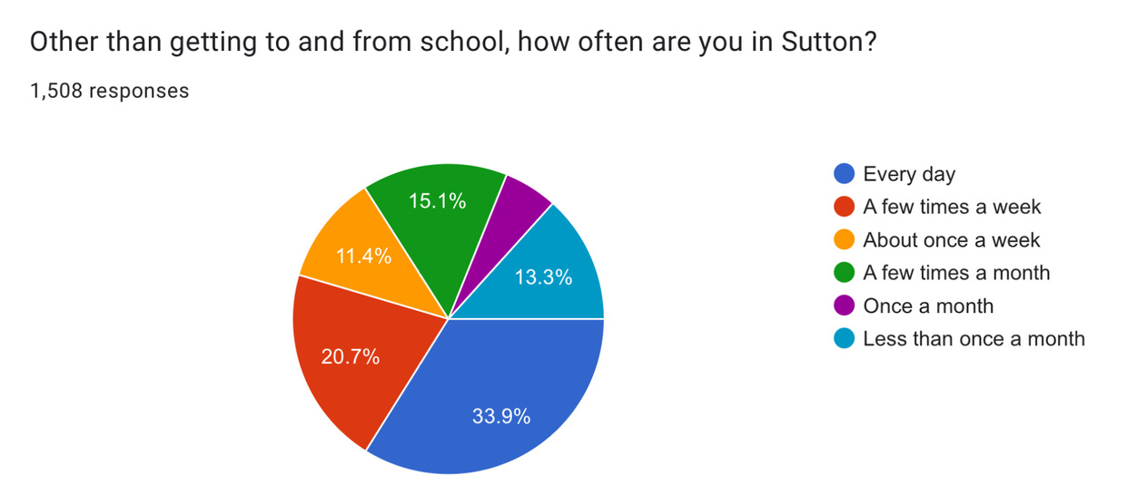
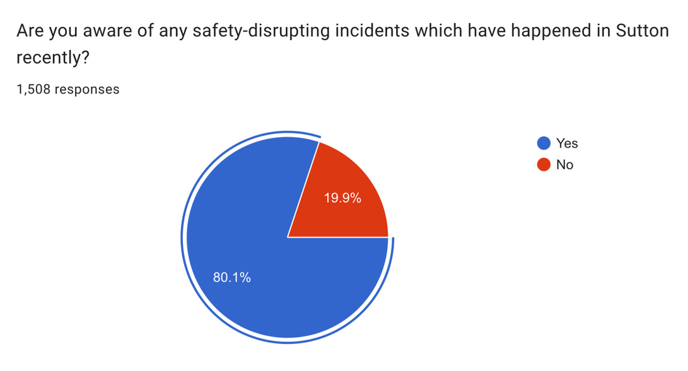
Key Data :
  Over 1,200 students who completed the survey responded that they had been aware of ‘safety-disrupting incidents’ within Sutton. Notably the stabbings in the High Street last year.
Sutton Safety Survey

Slide 5
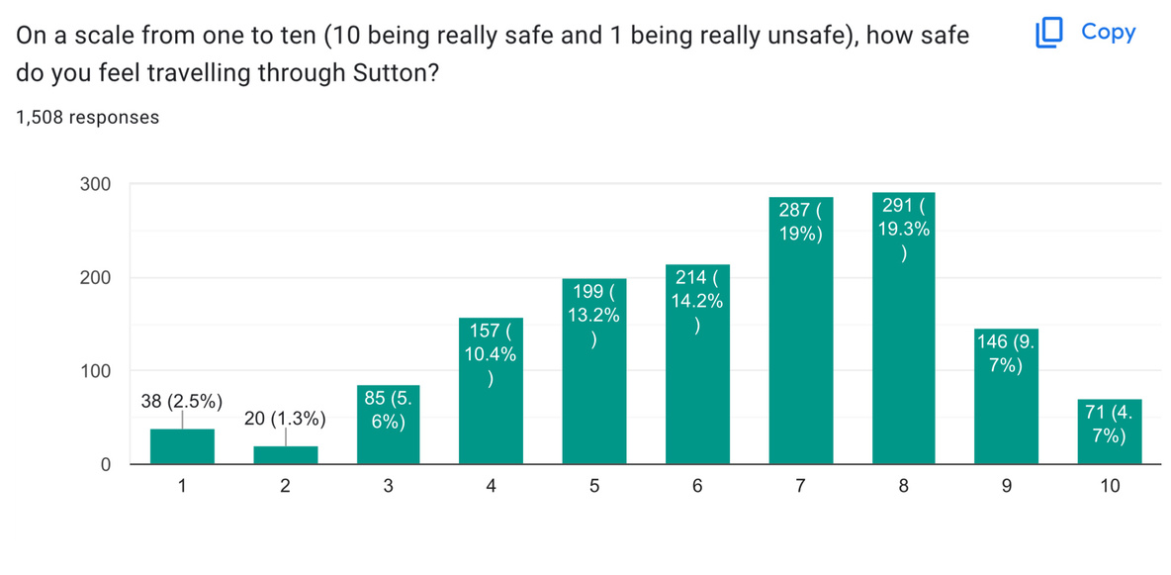
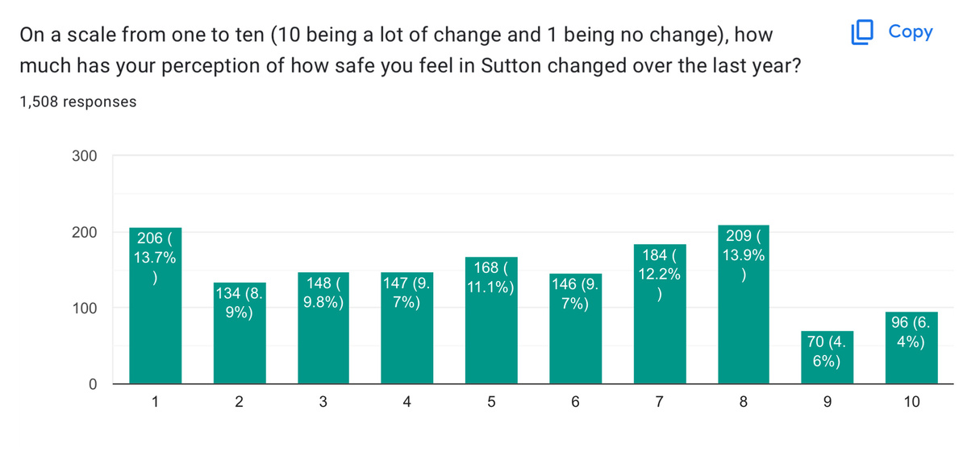
Key Data :
  Despite an awareness of such incidences young people feel relatively safe within Sutton.
  The highest number of students rated Sutton 7/8 out of 10 on safety.
  Overall mixed picture on changing feelings surrounding Sutton and safety as a consequence of recent crime within the borough
Sutton Safety Survey

Slide 6
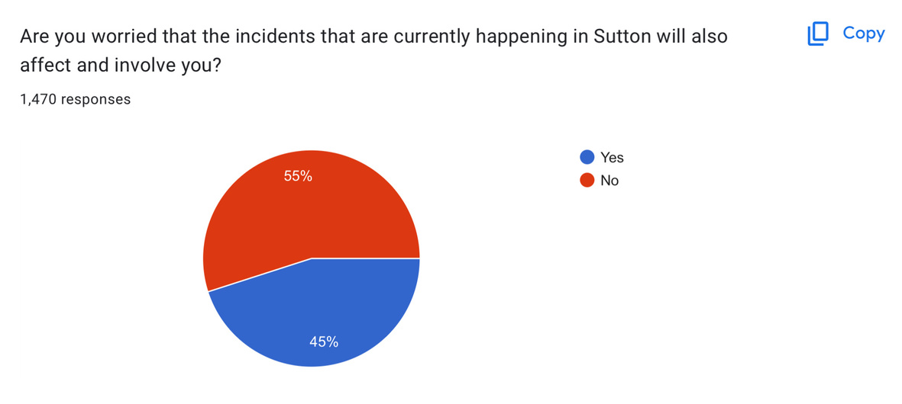
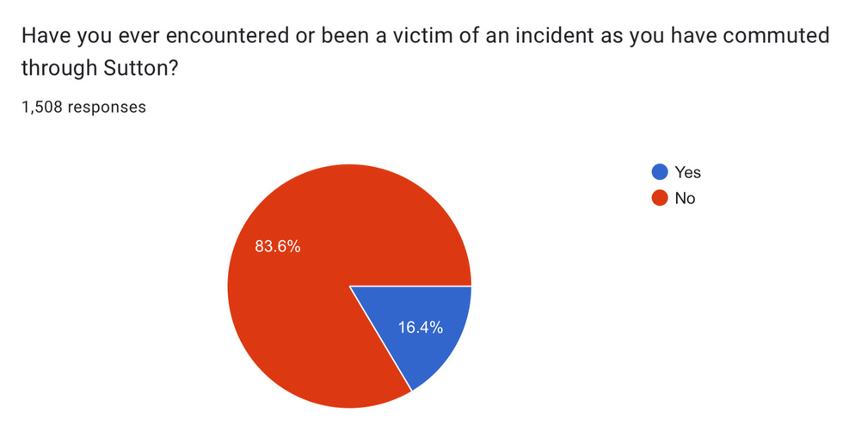
Key Data :
  large proportion of students are concerned that such incidences relating to knife violence in the borough may potentially affect or involve themselves (45%)
  248 out of 1,508 students have either witnessed or been a victim of an incident within Sutton
Sutton Safety Survey

Slide 7
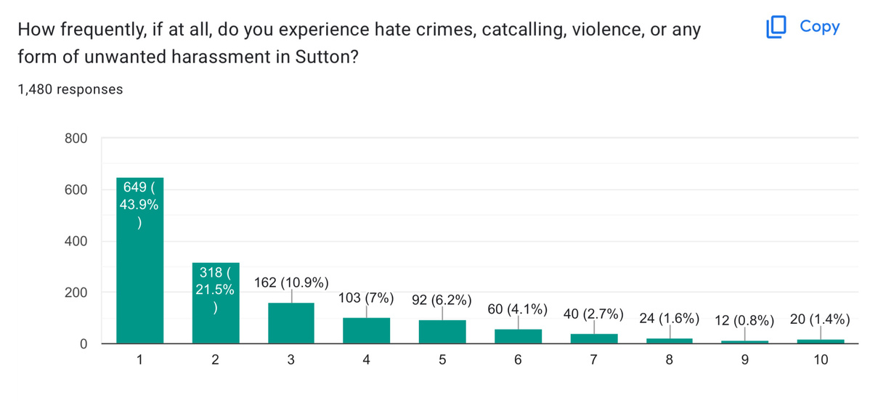
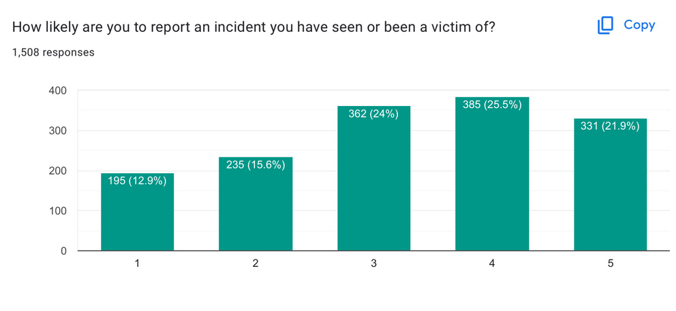
Key Data :
  Despite the number of students experiencing serious crime falling dramatically as the number of encounters increases, cumulatively nearly 250 respondents have experienced such crime as fequently more than 5 times.
  Overall mixed feelings upon students reactions to reporting an incident they have been a victim of
Sutton Safety Survey

Slide 8
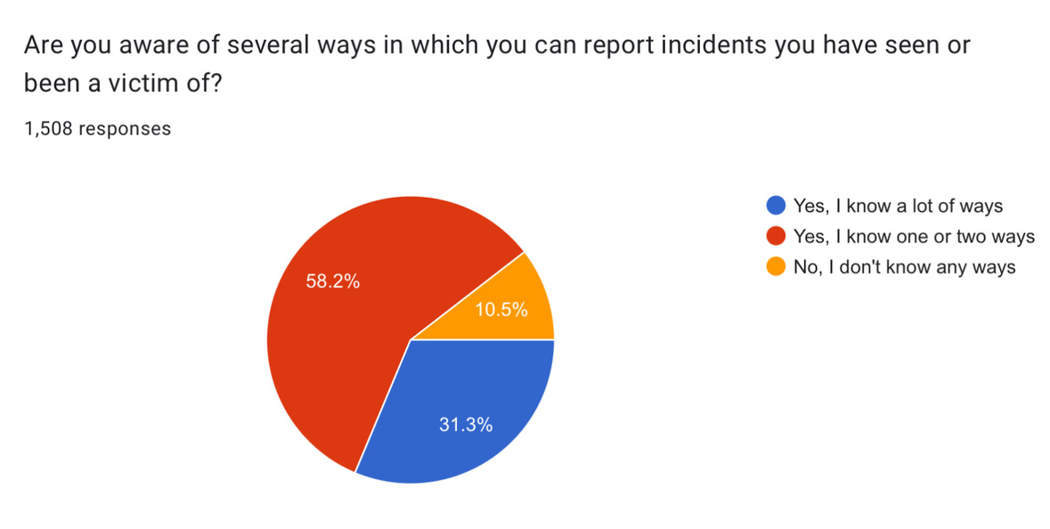
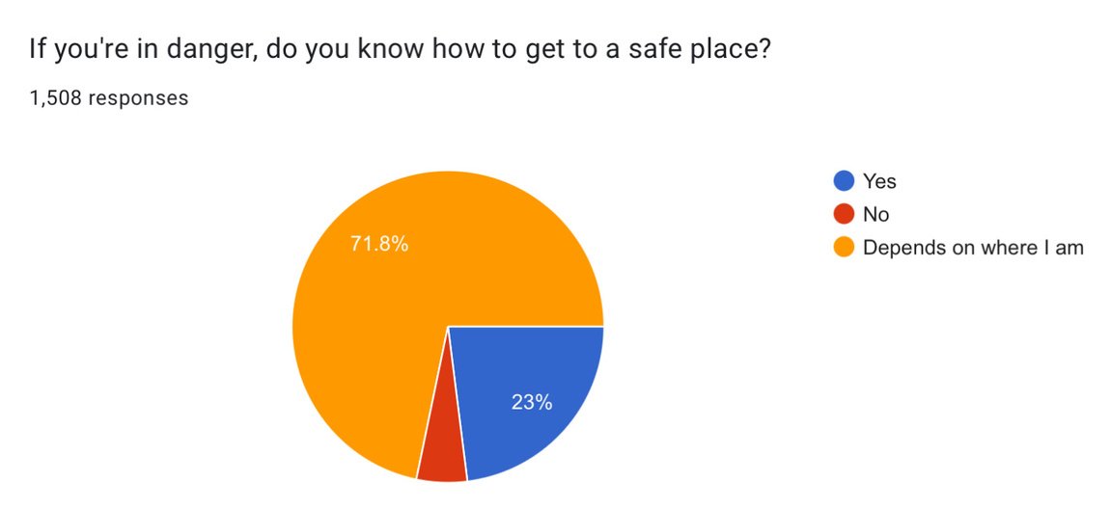
Key Data :
  Large proportion of students are unaware of ways in which they can report incidences they have seen/ been a victim of. Over 150 students.
  Uncertainty over how to reach a safe place - depends on area
Sutton Safety Survey

Slide 9
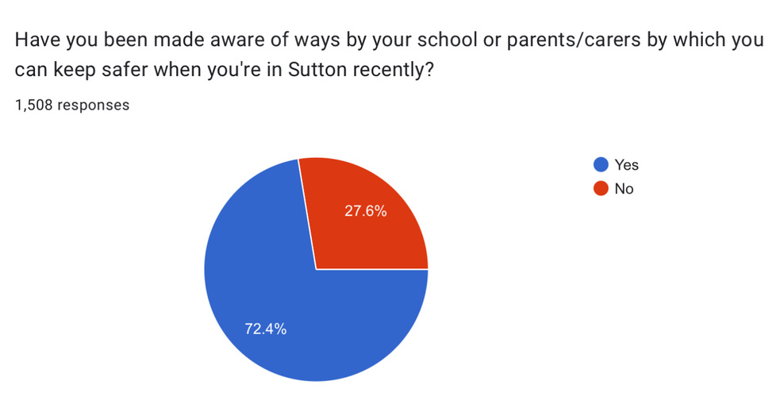
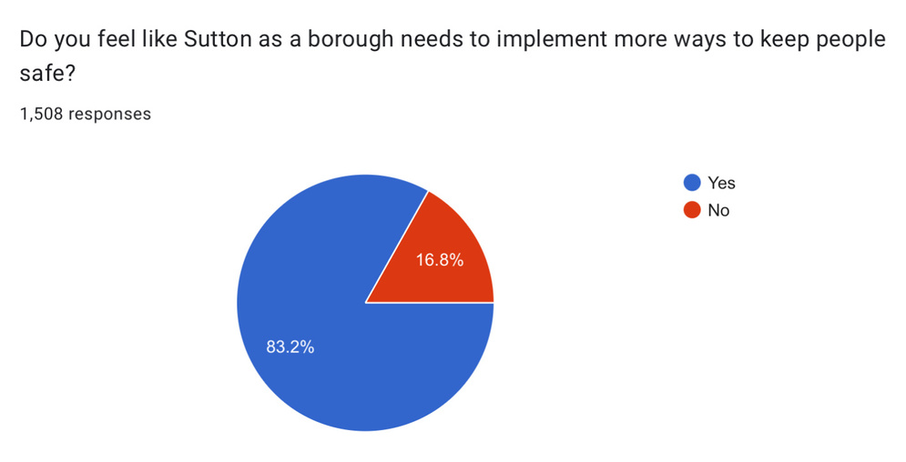
Key Data :
  Over 400 students to agreed that they have not been informed of ways in which they can stay safe in Sutton
  Over 1,200 students agreed that the borough needs to implement more ways to stay safe within Sutton
  There is a need to explore the ways in which keeping young people safe can be achieved
Sutton Safety Survey

Slide 10
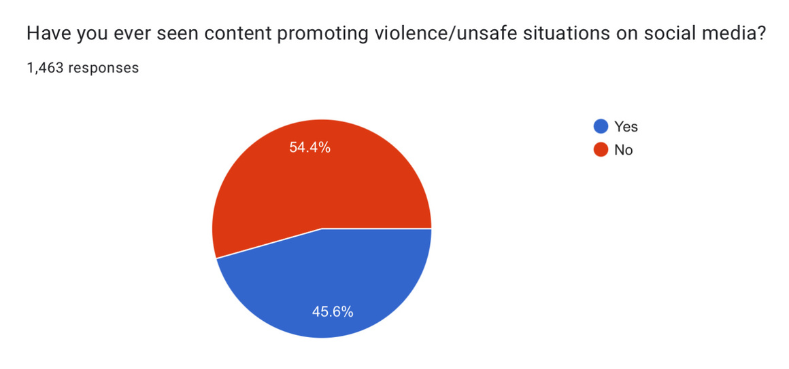
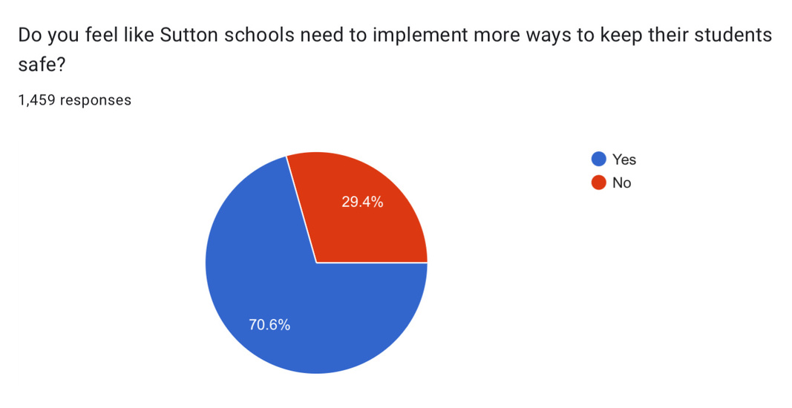
Key Data :
  Nearly half of all respondents have witnessed unsafe/ violent situations promoted on social media.
  Potential cause of knife crime/ violence within Sutton
  High levels on agreement that Sutton schools need to implement more ways to keep their students safe
  Conversations to be had on how this can be achieved.
Sutton Safety Survey

