Slide 1
Free, safe, anonymous and online mental health support
kooth.com

Slide 2
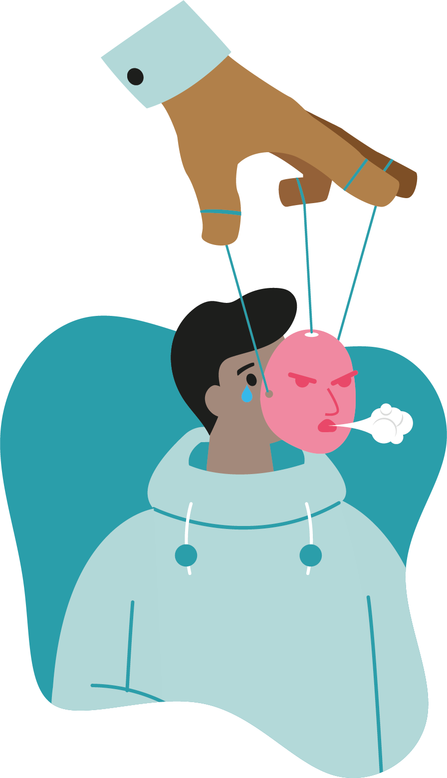
We want to promote safe spaces for everyone to feel comfortable to talk about how they're feeling and explore how Kooth can support you
Why we’re here today

Slide 3
Mental health is how we
think, feel and act in response to the things that happen to us in life
Just like physical health,
everybody has it and we need to take care of it

Slide 4
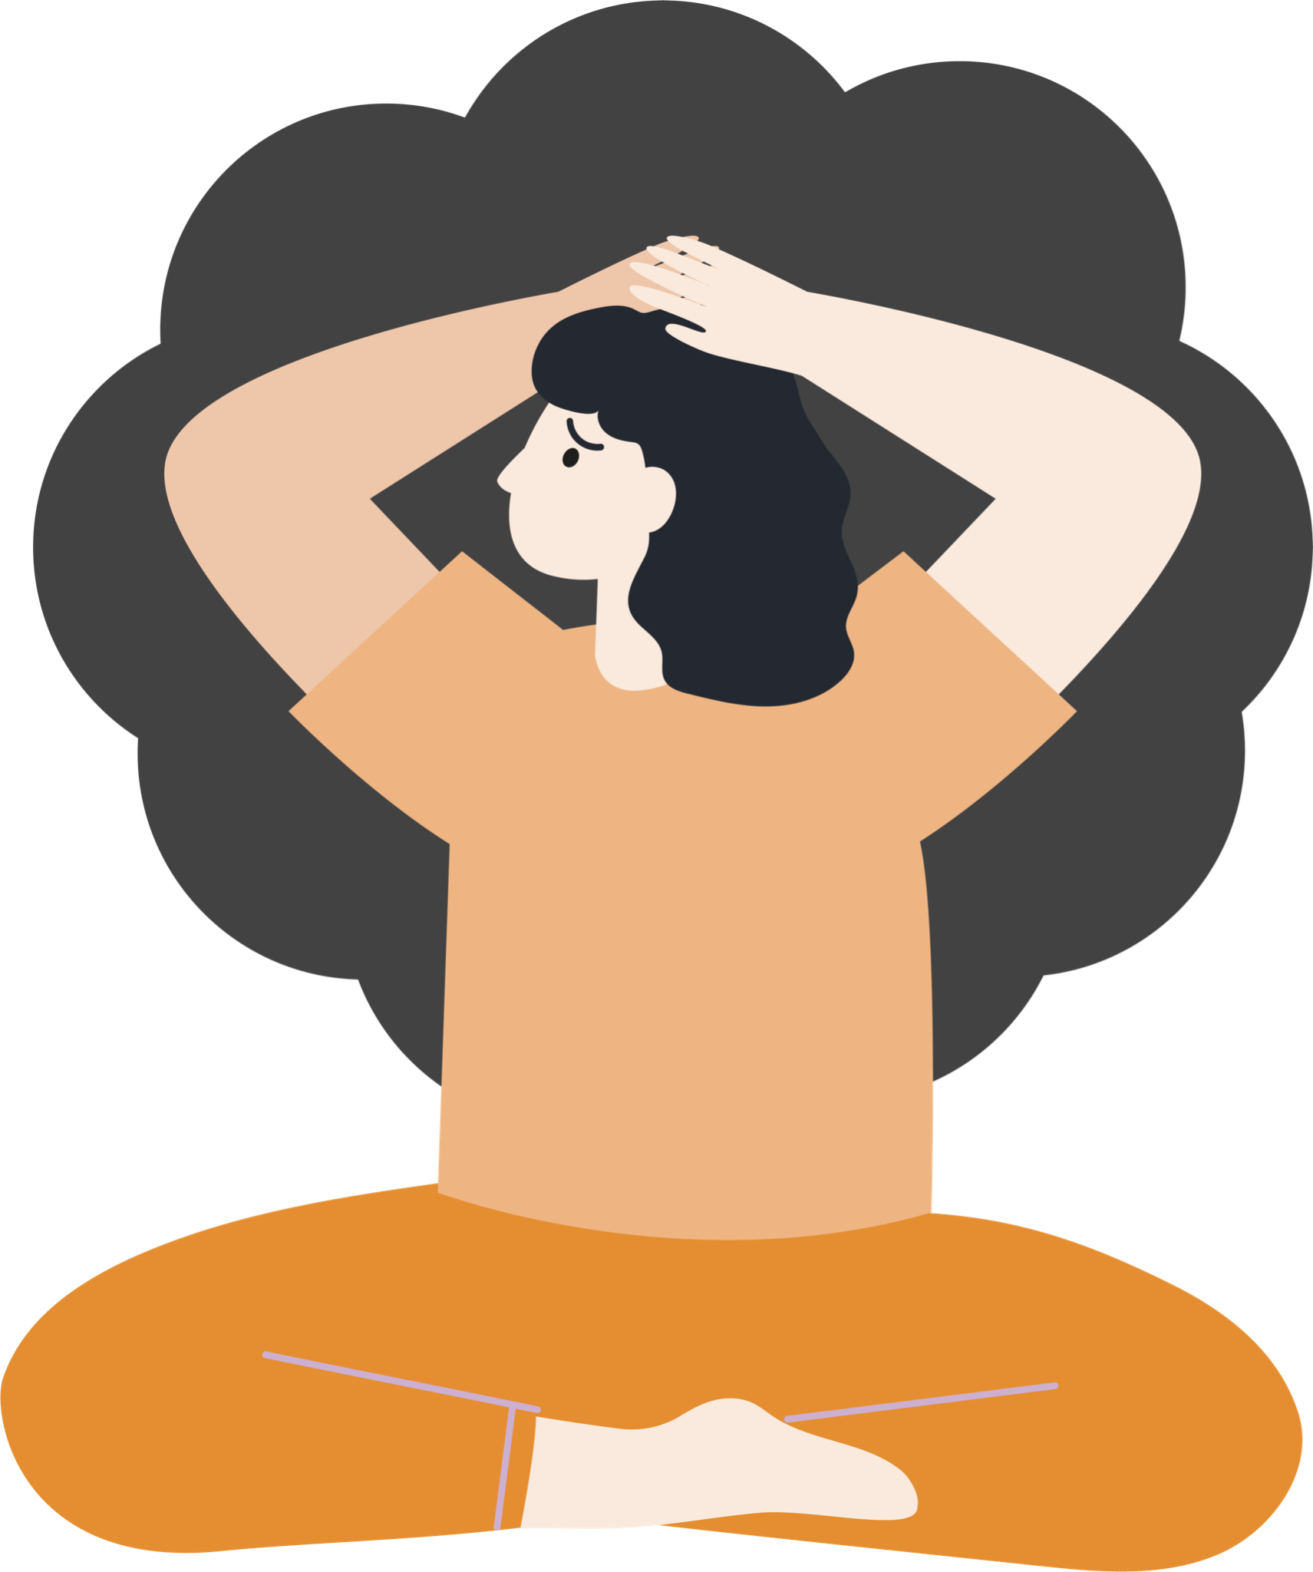
Our mental health can range from
good to poor
Good mental health can help you to think positively, feel confident and act calmly
Poor mental health may mean the way you’re thinking, feeling or acting becomes difficult to cope with

Slide 5
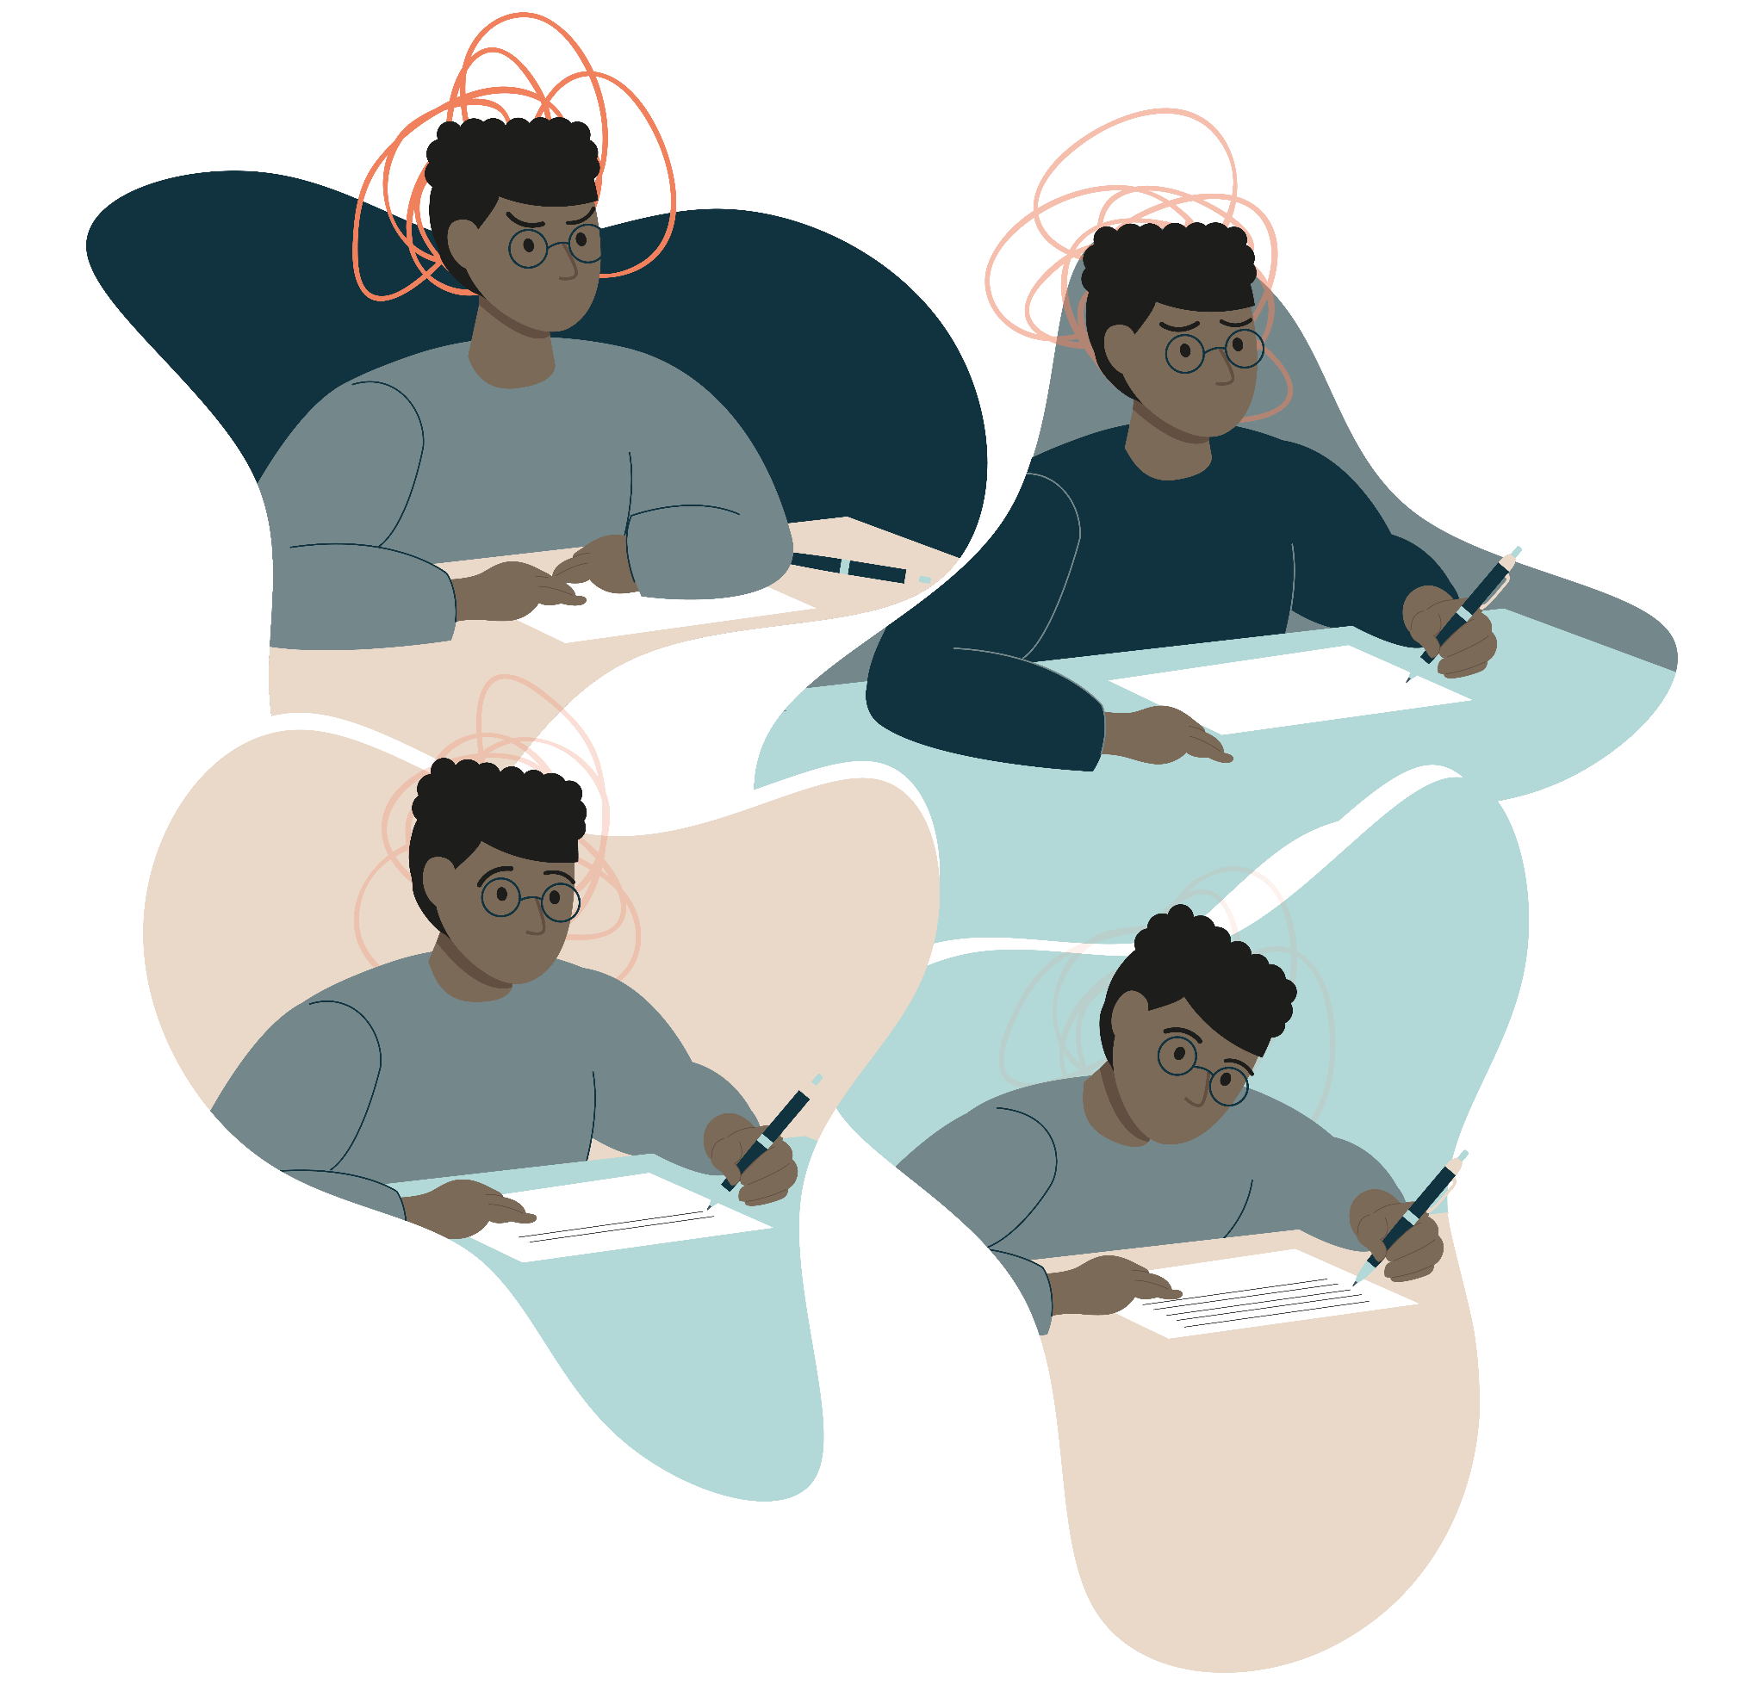
What can affect our mental health?
•School/ College
•Relationships
•Friendships
•Family
•Past experiences
•Social media
•Popularity/ fitting in
•Stress/ pressure
•Feeling isolated
•Gender/ Sexuality
•Bereavement
•‘Banter’

Slide 6
We asked young people what prevents them from talking about their mental health…

Slide 7
Here’s what was shared with us…
‘I don’t want to appear weak’
‘I’m nervous about the consequences’
‘I’m unsure how to express my emotions’
‘I’m fearful I’d be judged’
‘I’m too embarrassed’
‘I find it hard to trust others’
‘I feel too nervous’

Slide 8
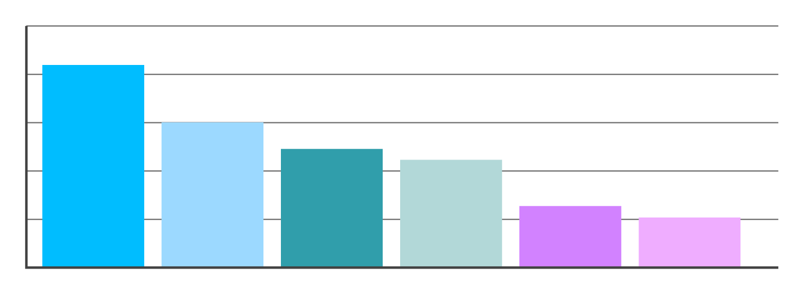
The mental health charity Mind spoke to a group of young men and found that they’d be more likely to seek support if…
Support and information was available online
An assurance of anonymity
Help was available at more convenient times of day
Help available at places other than a GP surgery
Help was available over their phone
Support was available in more places
Notes:
ADD INSERTS

Slide 9
KELs to add in insert slides
Max 6 additional slides according to presenting issue that the setting has suggested, or if you are presenting to a specific audience

Slide 10
A little bit about …
Your online mental wellbeing community

Slide 11
Click on the ‘Join Kooth’ button to get started

Slide 12
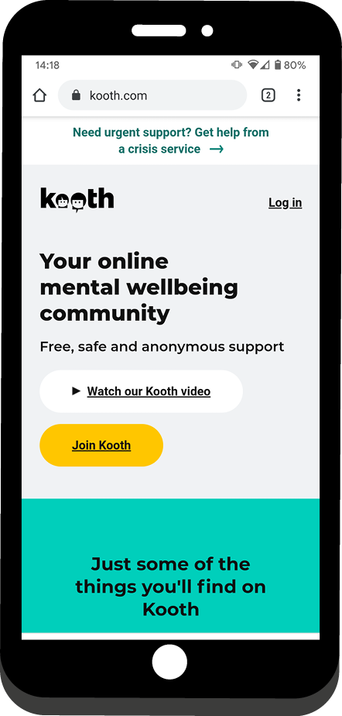
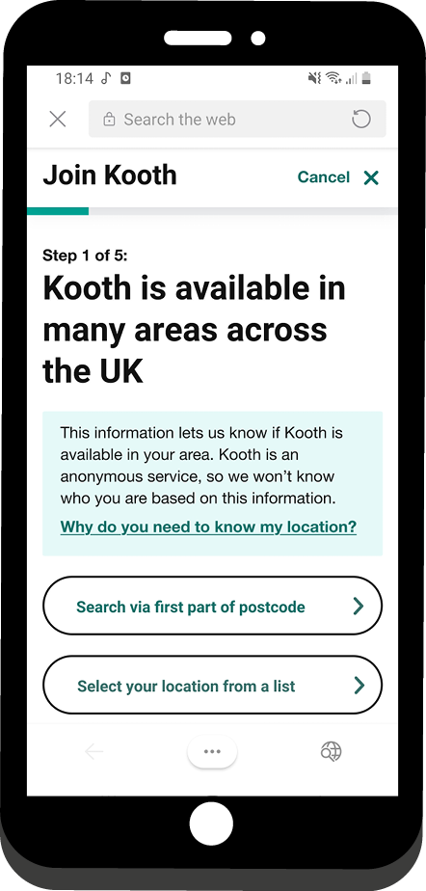
1. Select Join Kooth.
2. Sign up by postcode or select your location from our dropdown list.
How to sign up

Slide 13
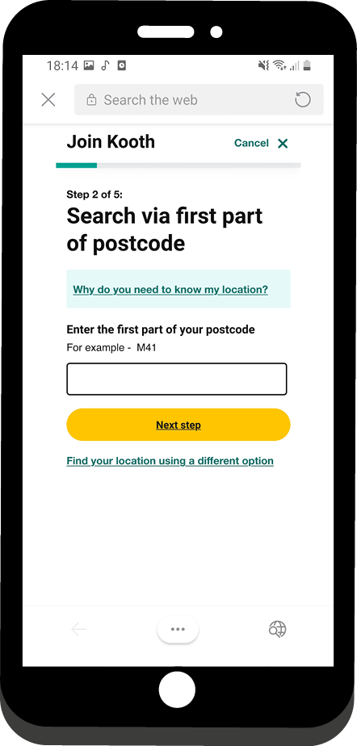
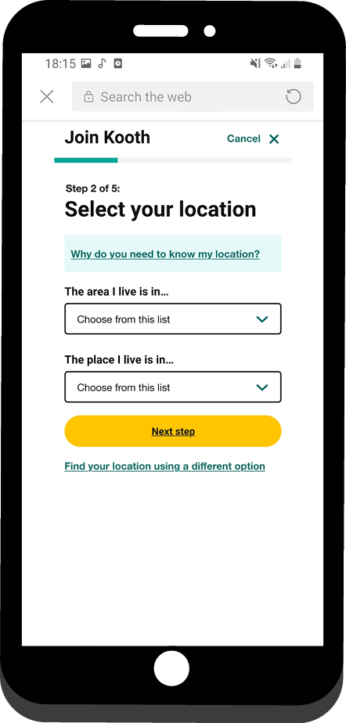
OR
3. Enter the first part of your postcode.
4. Choose your area
from the dropdown.
Notes:
Speaker notes:
The first part of your postcode will likely be the first 2,3 or 4 letters. For example, if your postcode is NW6 4RN, simply enter NW6.
Or, using the drop down list, you can choose your area and then choose the place that’s closest to you.
Guidance to KEL ‼️: Please try and ensure you know the area/location and sub-location/place for whatever school or setting you’re presenting in and try to emphasise this to your audience

Slide 14
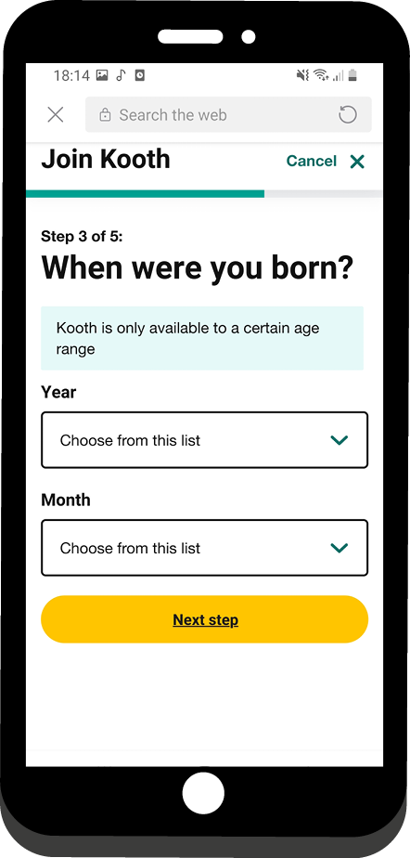
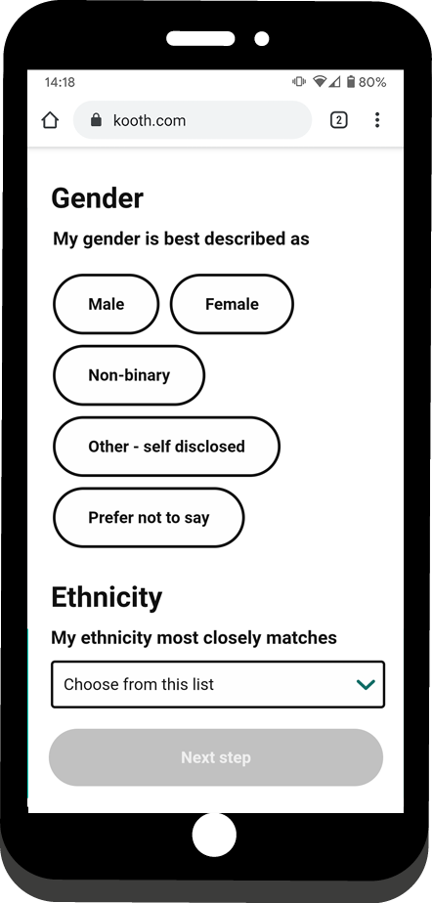
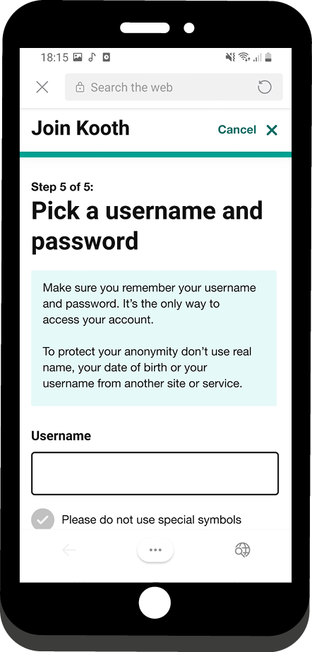
5. Select your month
and year of birth.
6. Select your gender and ethnicity.
7. Create an anonymous (not your real name) username and secure password.

Slide 16
Professional support
Self-directed
support
Community
support
Helpful articles
Live text-based chat
Send a message to our team
Activities
Journal space and Goal Setting
Discussion boards
Live forums
Notes:
OPTIONAL for those that want it

Slide 17
Your first chat session
You can usually get help on the same day you need it
When you first come to chat, we will:
Listen to you
Explore your current difficulties and what's brought you to Kooth
Think together about the best way to support you

Slide 19
Our team are here for you 365 days a year
You can chat with us during the following hours:
Monday - Friday 12pm - 10pm
Saturday and Sunday 6pm - 10pm

Slide 20
95%
of our users would recommend Kooth to a friend
Join over 1 million young people who have logged into Kooth.com
You can
trust us
Our team are
real people who want to listen and help

Slide 21
A range of self-help tools
all in one place
You can use these tools at any time
Options include:
Wellbeing mini activity hub
Journal space
Goal setting
Discussion boards
Live forums

Slide 22
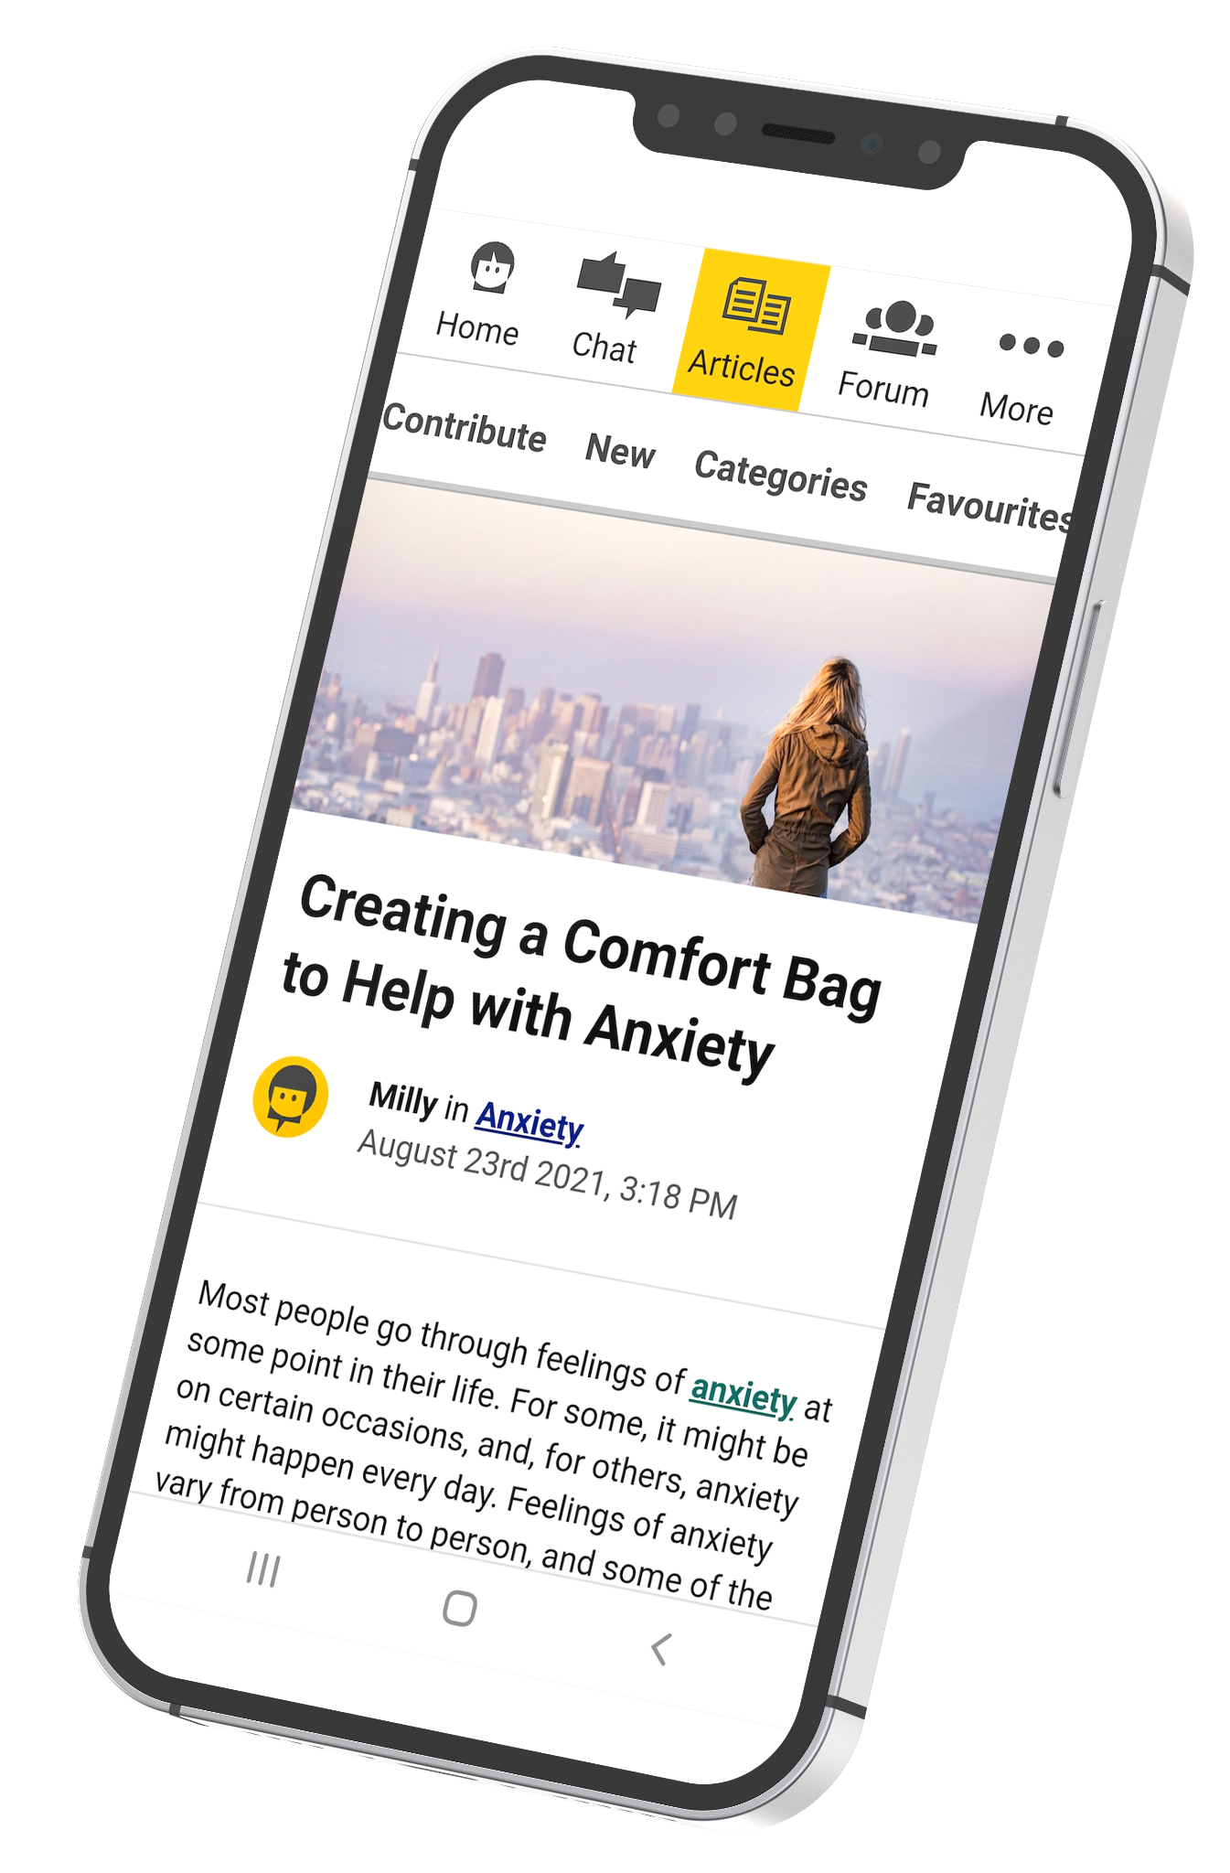
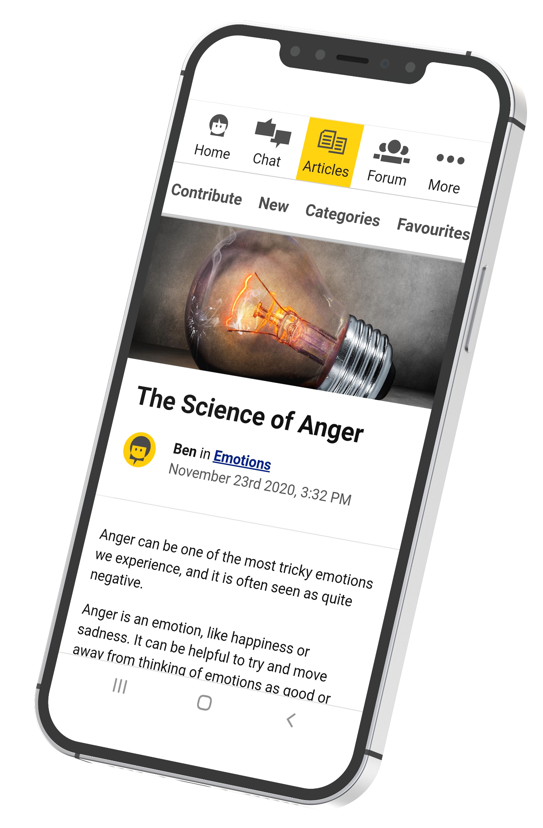
Article topics include:
Personal stories
Bullying
Relationships
Identity
Education
Hobbies and interests
General health and wellbeing

Slide 23
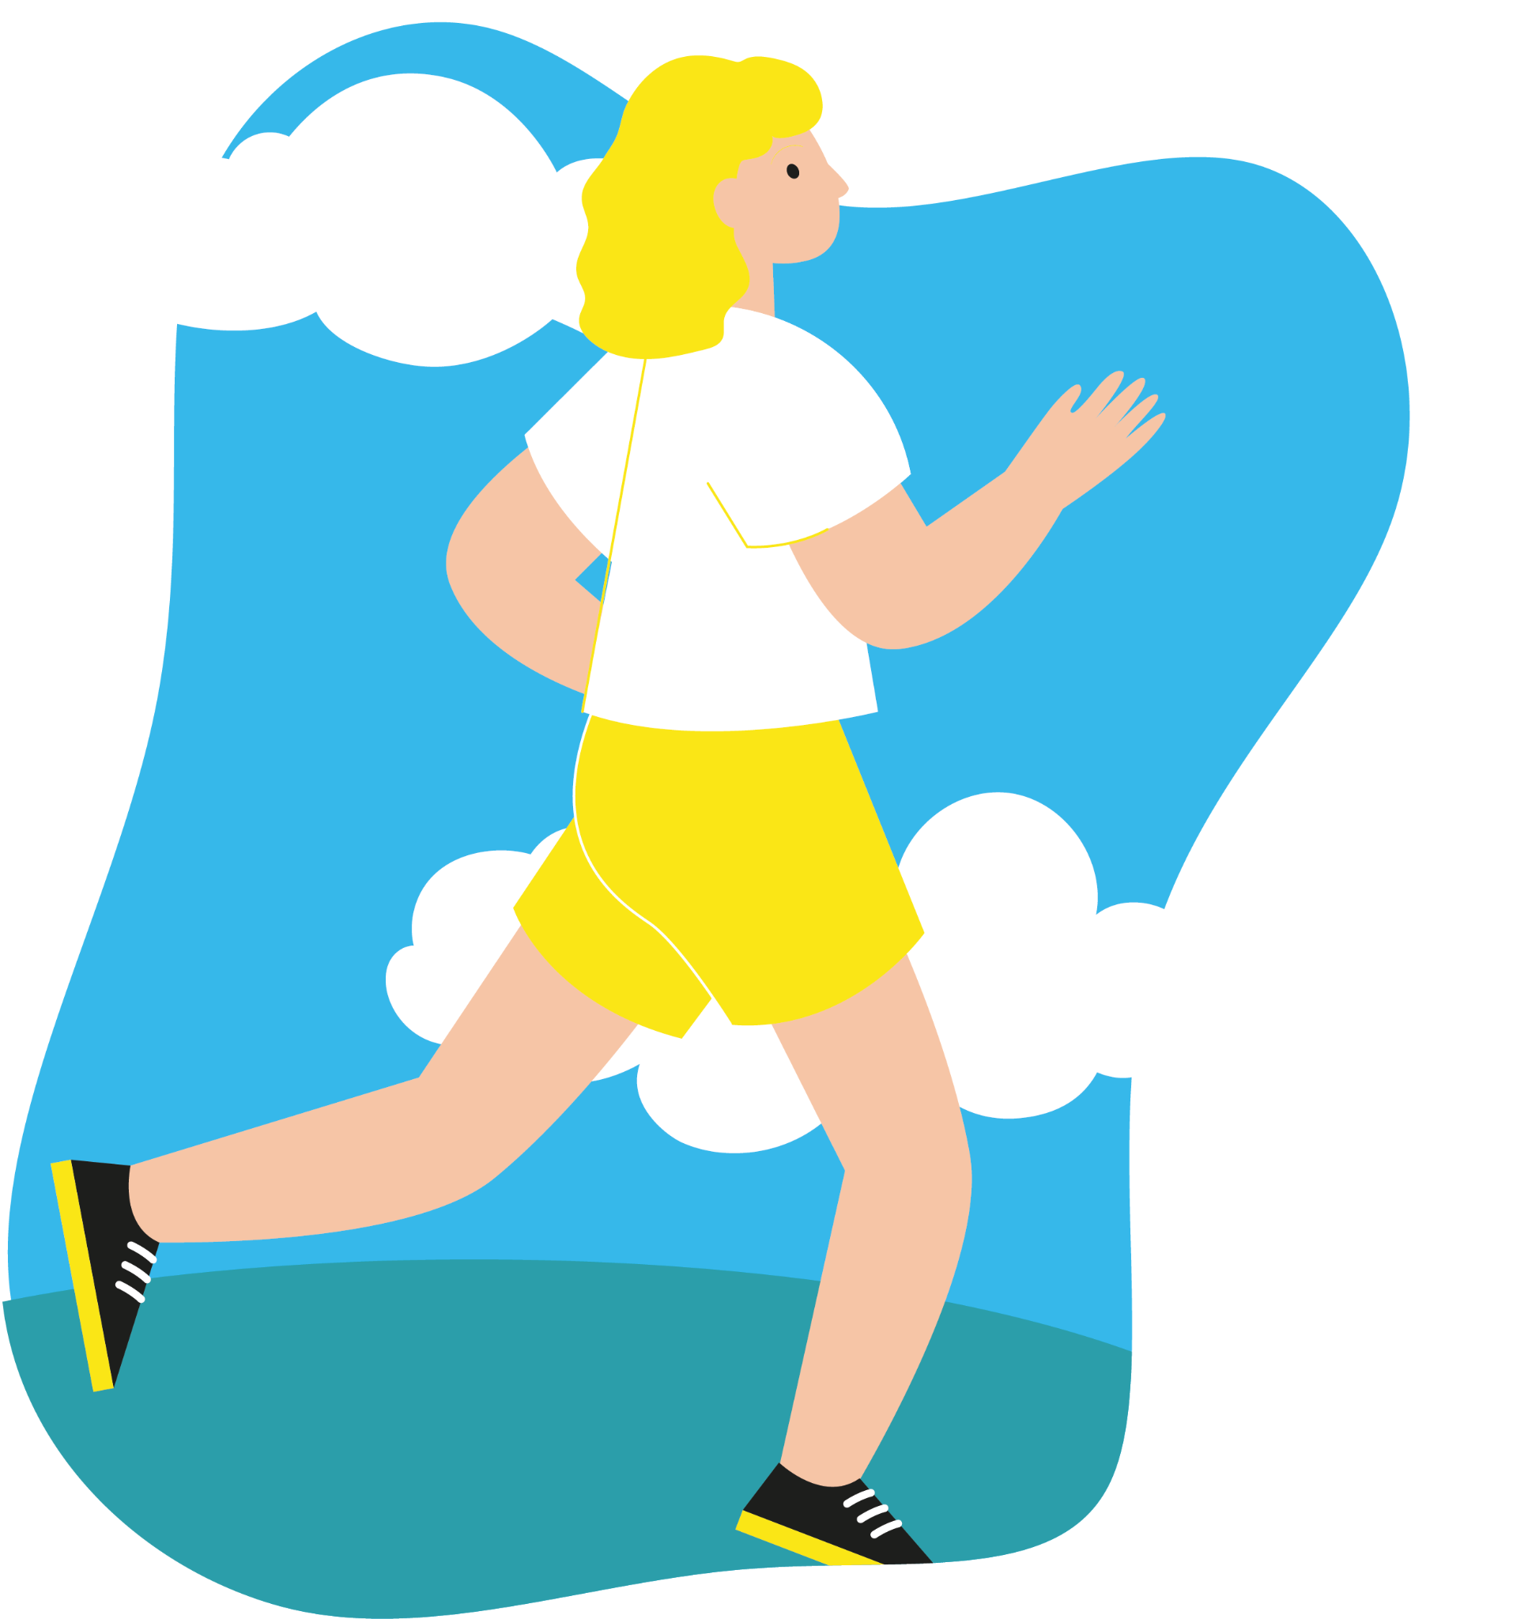
A few tips from us:
It’s ok to ask for help - it can be really difficult to manage your emotional wellbeing, so you don’t have to do it alone
Try to move or be active each day - being active and doing gentle movement
each day can help improve your wellbeing
Focus on what you’re good at - build on your strengths to
boost your confidence and self-esteem
Find helpful ways to experience, express and manage your emotions - you could try some Kooth mini-activities to help
develop helpful habits and valuable life skills, or listen to our of our podcasts

Slide 24
If any of today’s discussions have been difficult for you, and you’d like some additional support, please speak to your pastoral team

Slide 25
kooth.com
Everyone needs support sometimes - and if you do, we’re here
Free, safe, anonymous and online
kooth_uk
kooth_uk
kooth_uk

