Slide 1
OFF THE RECORD
@talkotr
talkofftherecord.org
info@talkofftherecord.org

Slide 2
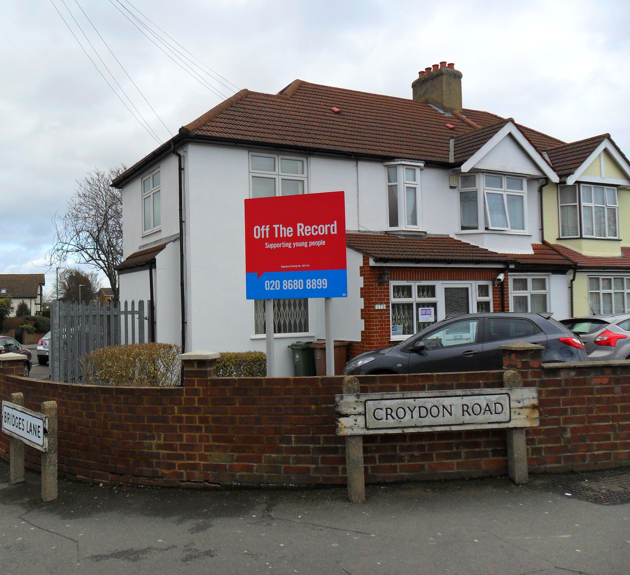
OFF THE RECORD – SUTTON SERVICE
sutton@talkofftherecord.org
020 8680 8899
172 Croydon Rd,
Beddington, Sutton
CR0 4PG

Slide 3
WEBINARS
Weekly – Thurs @ 5pm
NEXT ONE FOR YOUNG PEOPLE:
‘Improving your sleep’ (28th March)
REGISTER FOR THEM ON OUR WEBSITE:
Homepage > ‘What’s On’ >
Young people: > ‘Online workshops’
Parents / Carers: > ‘Support for parents / carers’

Slide 4
COUNSELLING (FACE TO FACE)

Slide 5
ONLINE COUNSELLING
1. On our website, click the subheadings ‘Croydon’,
‘Sutton’ or ‘Merton’ and there will be a tab under them
for the ‘Online Service’.
2. You will come to a page with a link you can click on:
3. This will take you to another page with lots of info about how it works
and how to register: talkofftherecordonline.org

Slide 6
KEEPING CONNECTED / YOUTH AMBASSADORS
talkofftherecord.org/youth-ambassadors/

Slide 7
DROP IN PHONE LINE
Our Support Line is open Monday to Saturday from 3-6pm.
Call us on 0800 980 7475.
Holiday hours are on our website.

Slide 8
OTHER BOROUGHS
Refugee Service
Young Carers Service
Community team
Support for young people in Croydon affected by youth violence
Mental Health Support Team in Schools
Peer support workers

