Slide 1
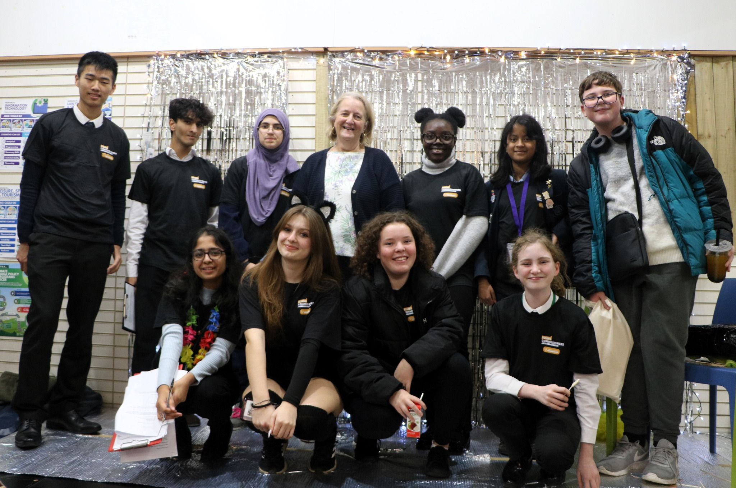
Sutton Youth Summit
Cost of Living Survey
November 2023 (analysis conducted in Jan 24)
Young Commissioners at the 2023 Sutton Youth Summit.
Photo from Volunteer Centre Sutton Facebook
Notes:
ADD IMAGE

Slide 2
Key findings
101 young people filled out the survey. Most of them were 12-17 years old (82%), and live in Sutton (69%).
Most young people surveyed (67%) have had to cut back on things like heating, food, or clothing due to the cost of living.
Many don’t know where to go for help with cost of living. 46% of young people surveyed said they either don’t know what help is available, or don’t know how to access it.
Young people suggested local government and community leaders can help families with the cost of living by:
investing in young people’s education and careers
increasing support to help families with the essentials
raising awareness of existing support

Slide 3
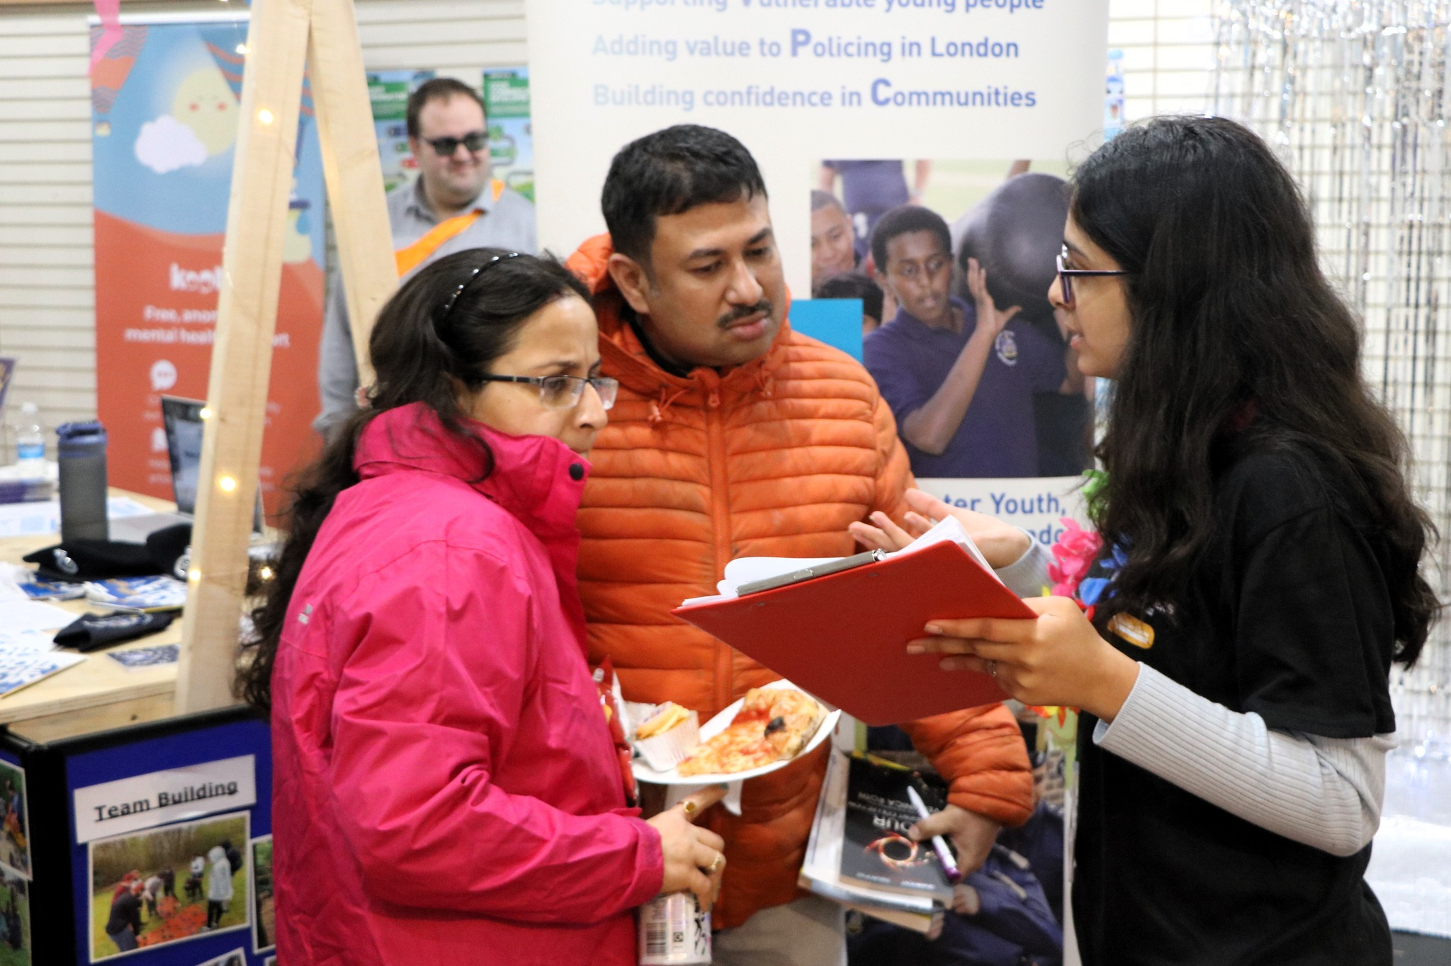
About the survey
This survey was created by young people for young people to gather information to help professionals target support for young people and families.
In November 2023, Young Commissioners organised the Sutton Youth Summit where they surveyed young people. The survey link was later posted on the Volunteer Centre Sutton website for others to share and complete.
In total, 101 young people filled out the survey.
2023 Sutton Youth Summit.
Photo from Volunteer Centre Sutton Facebook
This survey was made possible by grant funding from London Councils and the Mayor of London.

Slide 4
About Sutton
Nearly 1 in 3
people living in Sutton are aged 25 or younger.
Sutton has a higher proportion of young people aged 0-18 than the national average, but a slightly lower proportion of young people aged 19-25.
48%
of school pupils in Sutton are from Asian, Black, or mixed/multiple ethnic backgrounds.
Sutton’s youth are more diverse compared to the population as a whole.
More than 1 in 5
children in Sutton live in poverty.
This is lower than the national average.
91%
of 16-18-year-olds in Sutton go onto education or employment.
This is higher than the national average.
Who is at-risk from the cost-of-living crisis?
All Sutton residents are affected by rising prices. However those with lower incomes can face significant financial pressures as the cost of essentials like heating, food, and transport rise. This includes young adults, who are often more likely to be in low-paid employment or on zero-hours contracts.
Notes:
Minority ethnic youth population: taken from Sutton SNA https://docs.google.com/presentation/d/19nz8MXQMZlL_0yCatVPd8OskqyKtEjsUJeZxUoxaXEc/edit?usp=sharing
Youth population: Mid-year 2022 data taken from: https://www.ons.gov.uk/peoplepopulationandcommunity/populationandmigration/populationestimates/bulletins/populationestimatesforenglandandwales/mid2022
31.1% under 25s for Sutton vs. 30.4% for England and 32.2% for London. 24.7% under 18s for Sutton vs. 22.0% for England and 22.5% for London, 6.4% 19-25 for Sutton vs. 8.5% for England and 9.7% for London
Low-income households: data from June 2023 (for FY 2021/22) taken from https://endchildpoverty.org.uk/child-poverty/
21.8% for Sutton vs. 27% for UK vs. 32.9% for London
Continuing in education / employment: AY 2021/22 data taken from https://explore-education-statistics.service.gov.uk/data-tables/permalink/7fbef3fd-0b39-417d-aacf-08dc15deba2a
91.1% for Sutton compared to 82.6% for England
Groups more at risk: Taken from November 2023 Cost of Living dashboard Appendix B (22% households who accessed the foodbank service were single parent households) and Barnardo’s “At What Cost” report - flagging lone-parent households and young adults as groups particularly at risk
Icons created by Utami Febriarti, il Capitano and Cara Foster from Noun Project

Slide 5
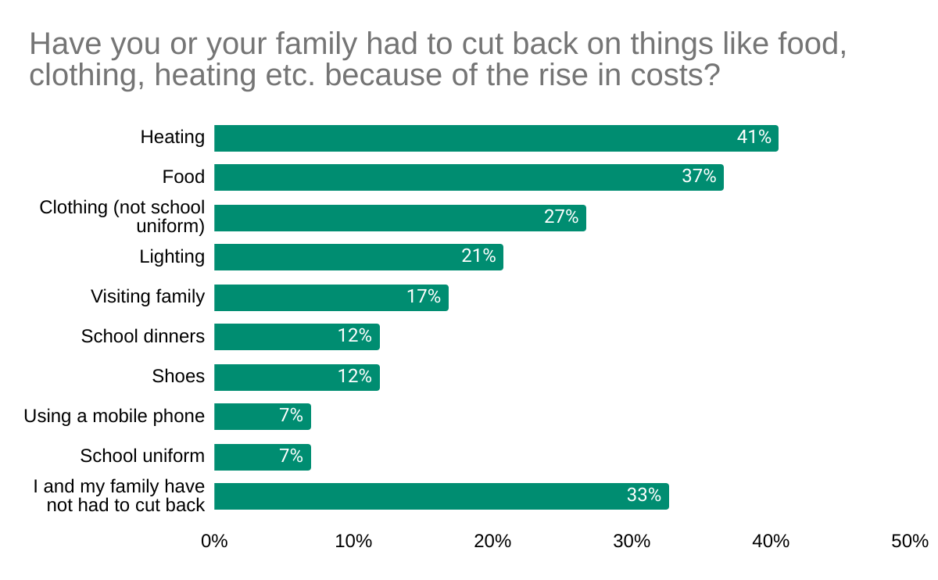
Cost of living is causing families to cut back on essentials
Two thirds of young people surveyed (67%) have had to cut back on things like heating, food, or clothing due to rising costs.
41%
have cut back on heating
37%
have cut back on food
Notes:
Note: percentages will sum to more than 100 as multiple answers could be selected by each respondent
Icon created by Cahya Kurniawan and Neha Tyagi from Noun Project

Slide 6
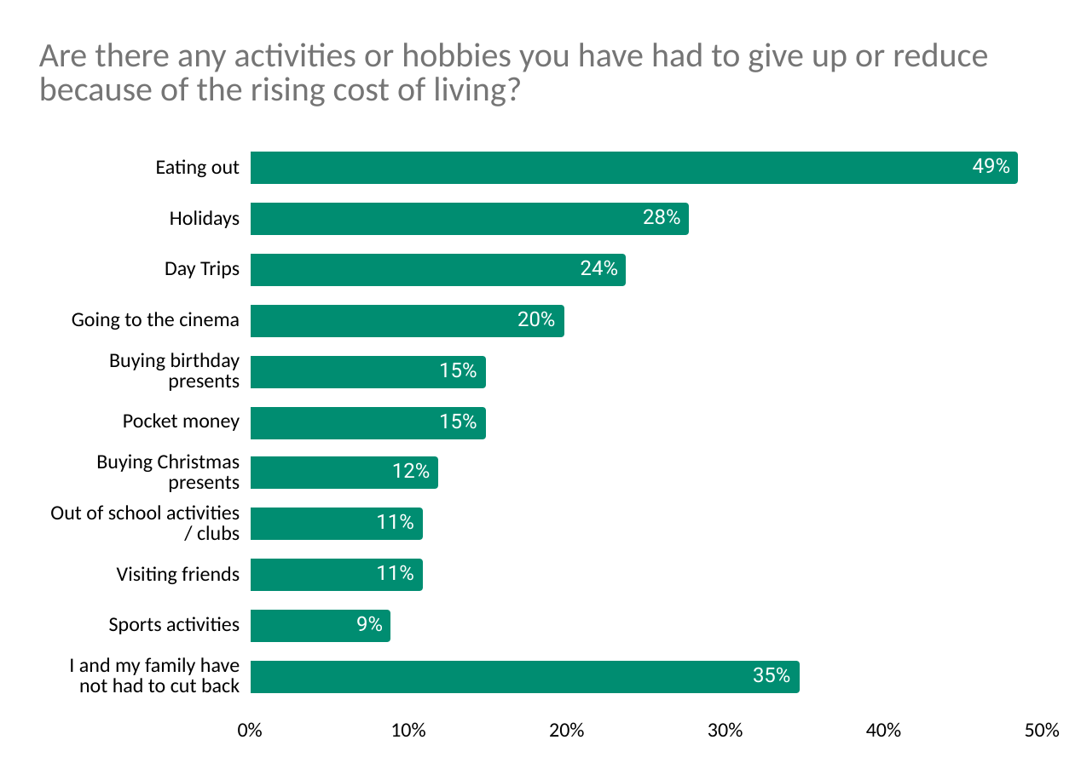
Rising costs are limiting hobbies and out-of-school activities
65% of young people surveyed said they had to give up or reduce activities because of the cost of living.
1 in 10
cut back on sports or out of school activities / clubs
1 in 10 have cut back on visiting friends
Notes:
Note: percentages will sum to more than 100 as multiple answers could be selected by each respondent
Importance of Extracurriculars / Out-of-School Activities
Social Mobility Commission. (2019). An unequal playing field: extra-curricular activities, soft skills and social mobility.
Extra-curricular activities are important to young people and result in a range of positive outcomes including social skills, achievement and attendance at school, and provide new skills and abilities.
Household income is by far the most important factor driving gaps in participation, especially music classes and sport.
Benefits of Sport Participation
Made by Sport. (2022). State of Play Report.
Young people who are physically active are 6.5x more likely to report high resilience skills and 5.4x more likely to report strong communication skills and confidence
Icons created by Gan Khoon Lay and Chanut is Industries from Noun Project

Slide 7
Cost of living is contributing to young people’s concerns about their future financial stability
On average, young people were moderately concerned about being able to afford higher education, housing, and other long-term goals.
1 in 8
were highly concerned
(i.e. gave a rating of 9 or 10)
On a scale of 1-10, Are you concerned about your future financial stability or ability to afford higher education, housing, or other long-term goals due to the cost-of-living crisis?
5
“We have had to cut down on a lot of things, so much that I am concerned that we may encounter financial difficulties in the near future.”
1
10
Very
Concerned
Not at all Concerned
average rating from young people

Slide 8
Most young people have spoken with their families about the cost of living
Nearly three quarters of young people surveyed (72%) said they have spoken to their families about the cost of living and its impact.
How did these discussion make young people feel?
“Conversations about it can get quite tense, as it’s a bit depressing”
38%
felt unhappy
45%
felt neither happy or unhappy
16%
felt happy
Notes:
Note percentages for emotions resulting from discussions exclude the 28 young people who responded that they “have not spoken to my family about this”
Felt unhappy includes all responses of “sad”, “a little sad” and “not so happy”
Neither includes all responses of “neither happy or sad”
Felt happy includes all responses of “happy”
Icons created by Mitochontrial from Noun Project

Slide 9
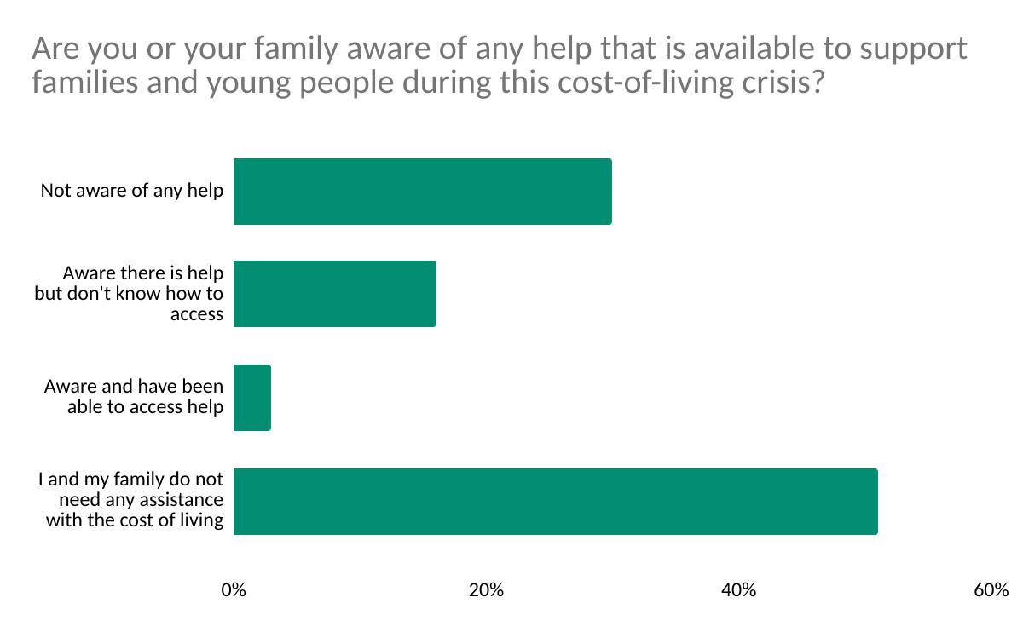
Awareness of available cost of living support is low
46% of young people surveyed either were not aware of any help, or did not know how to access help.
Excluding people who said they did not need support,
only 6%
of young people have been able to access help.
Notes:
Icon created by Gan Khoon Lay from Noun Project

Slide 10
Young people feel local government and community leaders could provide more support for the essentials.
Many young people’s suggestions focused on making essentials more affordable and accessible. Including:
reduce the cost of essentials like food, energy, housing, and transport. For local government / community groups, this could mean advocating for change at a national level to help achieve this.
help ease pressure on family budgets by providing more financial support, including for things like leisure activities and school supplies.
expand support for young people and families, for example, broader eligibility for Free School Meals and more funding for food banks.
“Open more shelters and community food charities because a lot more people I’ve seen have been turning to the streets and it would help them survive and get back on their feet”
“More universal grants… which could cover things like travel or books… free uniform vouchers and some more support in buying school PE kits too. This can help free up money to spend on food and heating, electricity or phone bills”
Notes:
Themes arising from free-text responses to:
Q11. What suggestions do you have for local government or community leaders to help young people and their families navigate the cost-of-living crisis more effectively?
Q12. Is there anything else that you would like to tell us about how the cost-of-living crisis is affecting you and your family?
Icons created by Demetria Rose, Nursila, and Rajive from Noun Project

Slide 11
Young people feel local government and community leaders could provide more support for the essentials.
“Ensure more bursaries / benefits, especially for those who are most impacted, as everyone’s life is different”
“Make school food cheaper and make heating and electricity cheaper as well”
“Invest as much money and resources as possible on giving struggling families a hand up. Programmes such as food banks and vouchers to keep leisure activities affordable”
“...you should increase Free School Meals for those who live just outside the eligibility bracket, as they are also impacted by the cost of living crisis. To do this, we prioritised things like food, lighting, heating, etc. but went out for leisure less.”
Notes:
Themes arising from free-text responses to:
Q11. What suggestions do you have for local government or community leaders to help young people and their families navigate the cost-of-living crisis more effectively?
Q12. Is there anything else that you would like to tell us about how the cost-of-living crisis is affecting you and your family?
Icons created by Nicky Knicky and Lars Meiertoberens from Noun Project

Slide 12
Young people feel local government and community leaders could invest more in support for youth.
“Invest in education, especially higher education, work experience, careers advice”
Young people emphasised the importance of investment in education, training, and career opportunities.
Several suggestions highlighted the cost of higher education and included ideas like increased scholarships and the reduction or removal of tuition fees.
“… the UK government should invest more in supporting young people in our current financial crisis.”
Notes:
Themes arising from free-text responses to:
Q11. What suggestions do you have for local government or community leaders to help young people and their families navigate the cost-of-living crisis more effectively?
Q12. Is there anything else that you would like to tell us about how the cost-of-living crisis is affecting you and your family?
Icon created by Rusurinusuhu from Noun Project

Slide 13
Young people feel local government and community leaders could increase awareness of existing support.
“Spread awareness about facilities and groups available to young people ”
Young people suggested more could be done to raise awareness of available support for young people and families.
For example using flyers or awareness campaigns, ensuring schools are knowledgeable of what is on offer, and running more workshops and engagement activities like the Sutton Youth Summit.
“Make the schools more aware of these situations in order to further educate students”
“...having more workshops or activities linked to cost-of-living and being able to understand it in depth”
Notes:
Themes arising from free-text responses to:
Q11. What suggestions do you have for local government or community leaders to help young people and their families navigate the cost-of-living crisis more effectively?
Q12. Is there anything else that you would like to tell us about how the cost-of-living crisis is affecting you and your family?
Icon created by Juan Pablo Brave from Noun Project

Slide 14
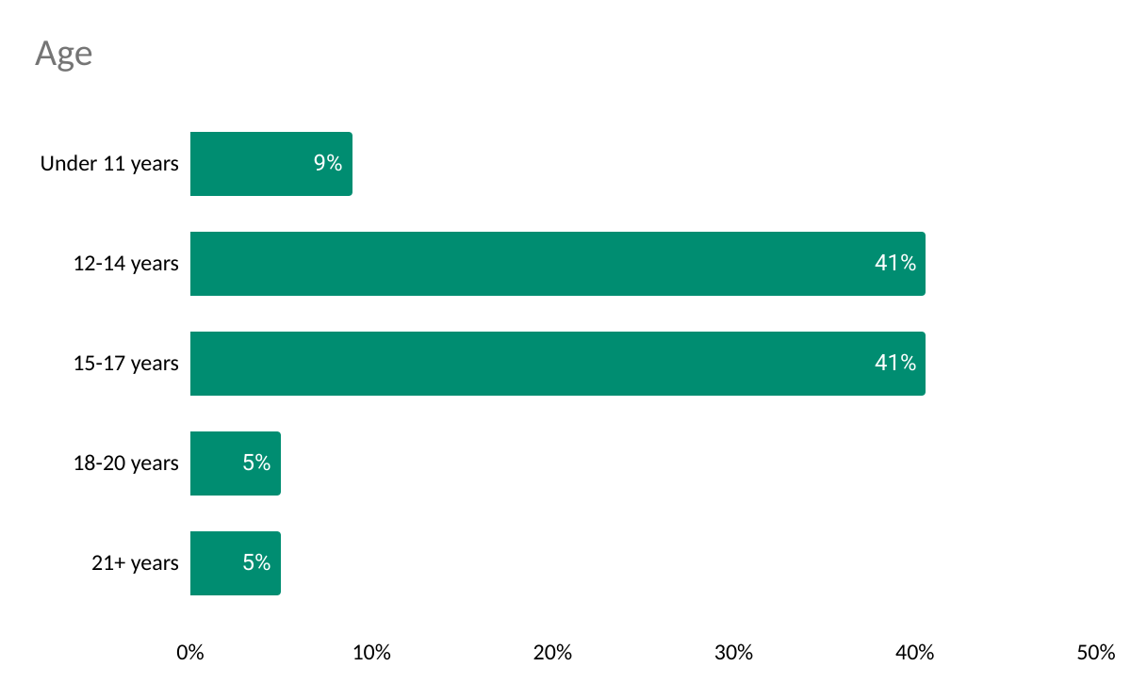
Appendix: Demographics and Additional Needs
101 total survey responses.
Area | %
Sutton | 25
Wallington | 17
Hackbridge / Beddington / St. Helier | 8
Worcester Park / North Cheam | 7
Carshalton / Belmont | 7
Cheam | 6
I do not live in Sutton* | 31
To avoid small numbers, some categories have been combined. *Sutton has a larger than average cohort of pupils living out of borough, so this number may represent children who go to school in Sutton but live outside Sutton.
Additional Needs | %
I have additional needs / learning difficulties | 7
I am a Young Carer | < 5
I am care experienced | < 5
None of these apply to me | 86
All Icons used in this report are from the Noun Project licenced under Creative Commons
Notes:
*Secondary school pupils attending school outside of local authority = 20% for London and much higher for boroughs neighbouring Sutton (28% for Croydon, 39% for Merton, 19% for Kingston)

